Slide 1

Heart Failure Prediction
Oleh Kelompok 4 DS01:
Fahrul Rozi
Febriana Sulistya
Fauni Ambarsari

Slide 2
Introduction
Cardiovascular diseases (CVDs) are the number 1 cause of death globally, taking an estimated 17.9 million lives each year, which accounts for 31% of all deaths worlwide.
Heart failure is a common event caused by CVDs and this dataset contains 12 features that can be used to predict mortality by heart failure.
Most cardiovascular diseases can be prevented by addressing behavioural risk factors such as tobacco use, unhealthy diet and obesity, physical inactivity and harmful use of alcohol using population-wide strategies.
People with cardiovascular disease or who are at high cardiovascular risk (due to the presence of one or more risk factors such as hypertension, diabetes, hyperlipidaemia or already established disease) need early detection and management wherein a machine learning model can be of great help.

Slide 3
Business Understanding
How does each feature affect the distribution of death events?
How is the correlation among features?
How is the heart failure prediction model?

Slide 4
Analytic Approach
Predictive : Logistic Regression
Logistic regression measures the relationship between the categorical dependent variable and one or more independent variables by estimating probabilities using a logistic function, which is the cumulative distribution function of logistic distribution.

Slide 5
Data Requirements
Data patients based on death event, age, sex, patient’s smoking habits. llevel of creatinine phosphokinase, precentage of ejection fraction, number of platelets in blood, level of serum creatine and serum sodium, time of follow up, data of patients suffers from anemia, diabetes, and high blood pressure.

Slide 6
Data Collection
Data is collected from Kaggle at:
https://www.kaggle.com/andrewmvd/heart-failure-clinical-data

Slide 7
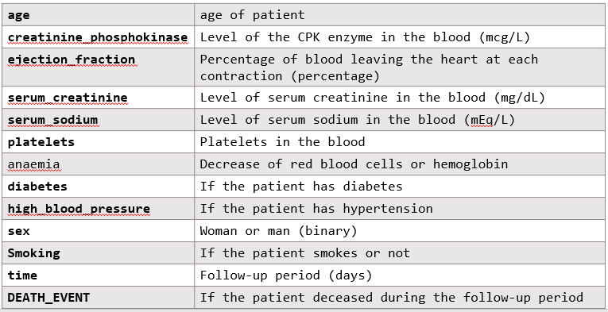
Data Understanding

Slide 8
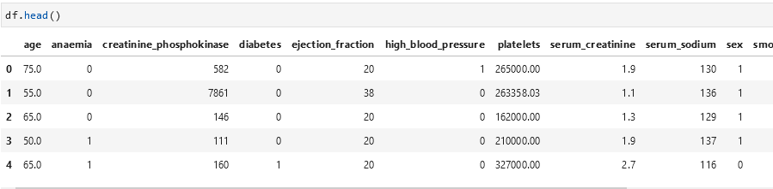
Data Understanding

Slide 9
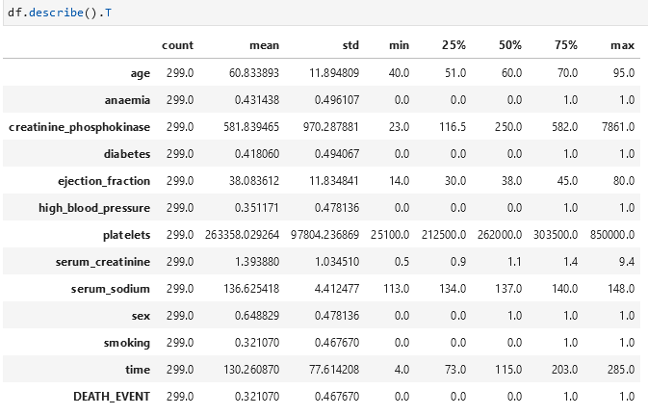
Data Understanding

Slide 10
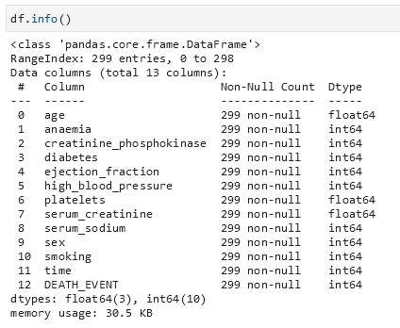
Data Understanding

Slide 11
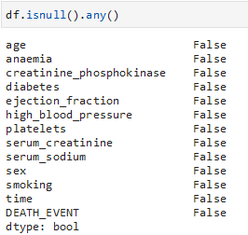
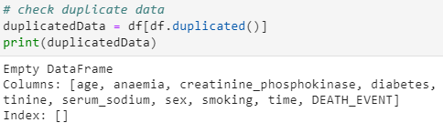
Data Preparation
Check Missing Value
Check Duplicated Data

Slide 12

Exploration Data Analysis
Distribution of death event

Slide 13
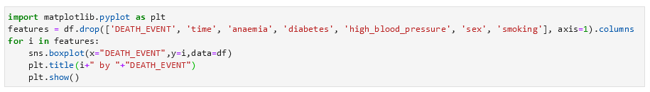
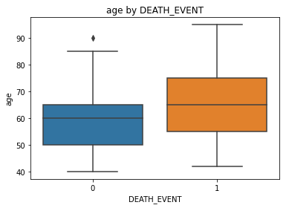
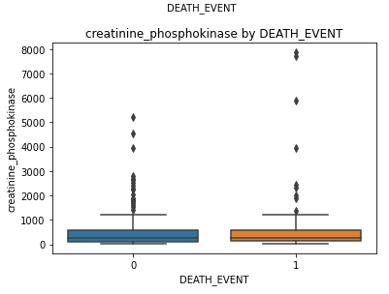
Distribution of Death Event

Slide 14
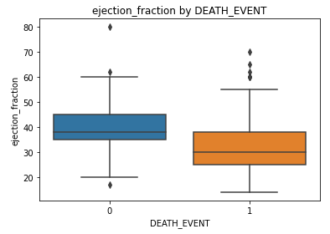
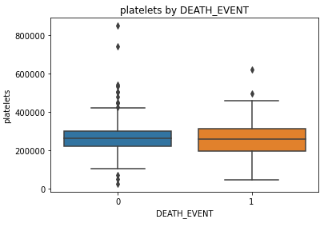
Distribution of Death Event

Slide 15
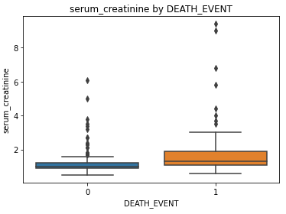
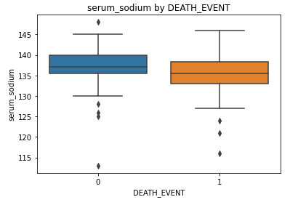
Distribution of Death Event

Slide 16

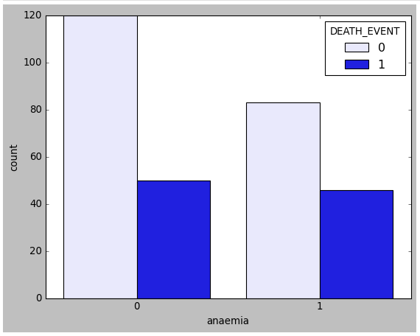
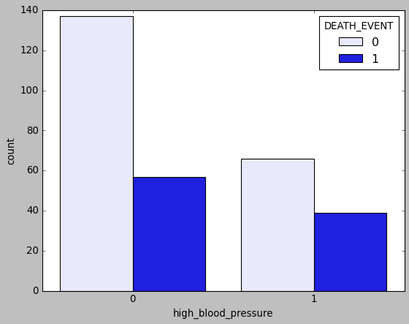
Distribution of Death Event

Slide 17


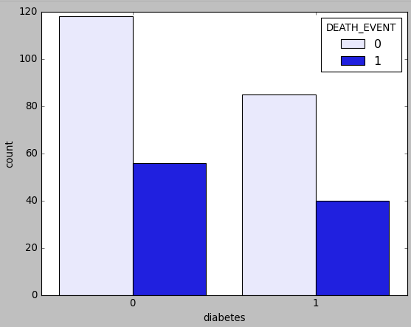
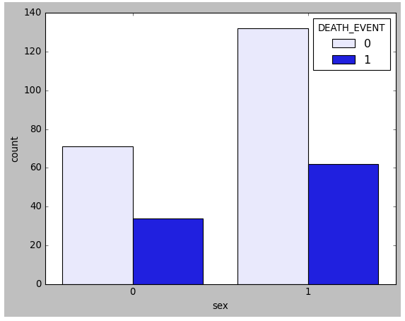
Distribution of Death Event

Slide 18
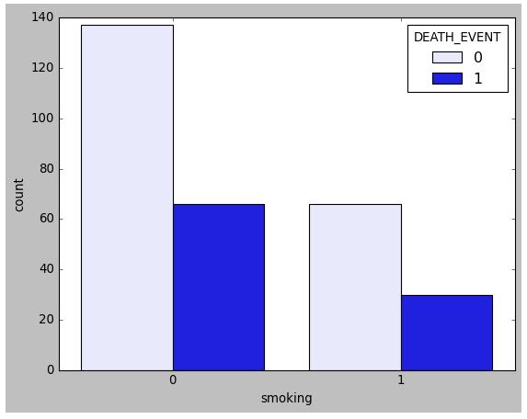

Distribution of Death Event

Slide 19

Exploratory Data Analysis
Correlation among features

Slide 20
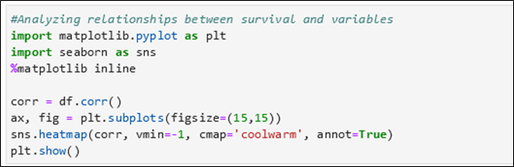
Analyzing relation between survival and each features

Slide 21
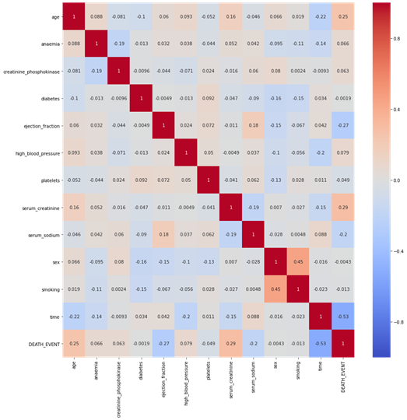
Heatmap of the correlation matrix
Heatmap di samping menunjukkan adanya hubungan yang lemah antar tiap variabel.

Slide 22
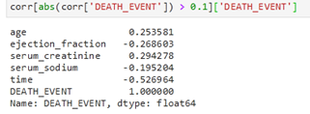
Berikut adalah langkah untuk mengetahui variabel yang memiliki korelasi yang lebih besar darpada variabel lain terhadap DEATH_EVENT.
Variable age dan serum_creatinine memiliki hubungan positif terhadap DEATH_EVENT, sedangkan variabel ejection_fraction, serum_sodium, dan time memiliki hubungan yang negatif.

Slide 23
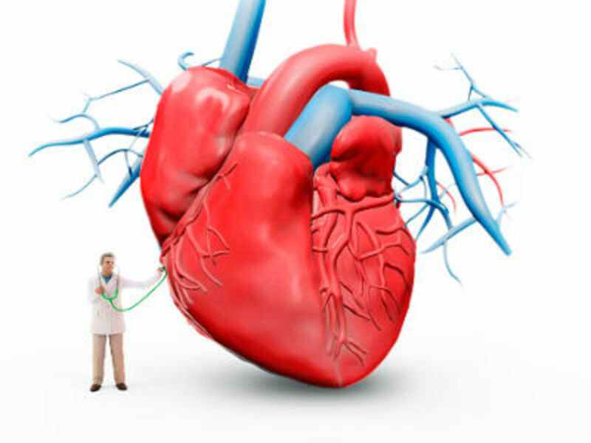
Prediction Model
Logistic Regression Approach

Slide 24
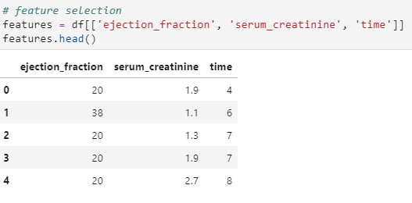
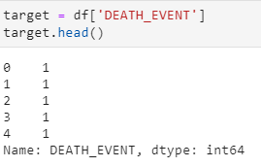
Feature Selection

Slide 25

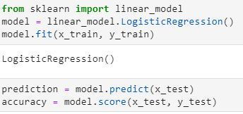
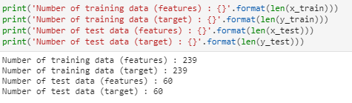
Logistic Regression

Slide 26
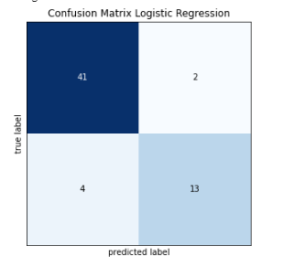
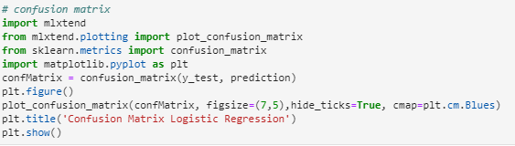
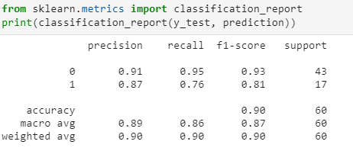
Confusion Matrix

Slide 27

Thank You

